Slide 1
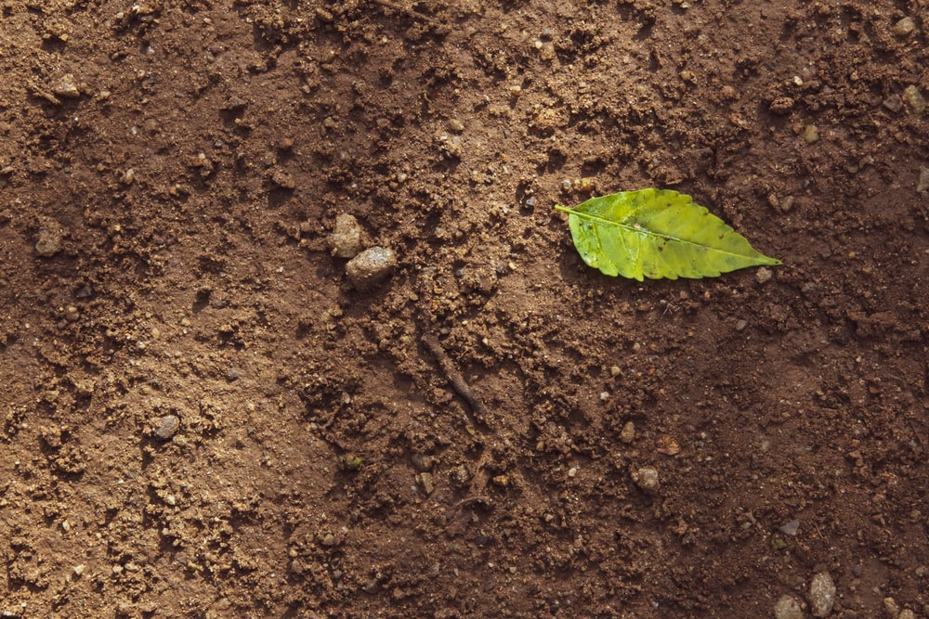
Soil Types Guide Sheet

Slide 2
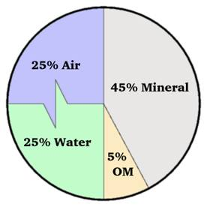
Soil Composition
Soil comprises four main components:
Minerals ~45%
These mainly include sand, silt, and clay
The breakdown of these three items indicates soil type
Air + Water ~25% each
Both are crucial for plant roots
Roots absorb water and are able to grow through air
within the soil
The exact percentages of air and water vary often by
soil hydration
Organic Matter(OM) ~5%
Contains the nutrients that plants need to grow
Can be replenished through composting

Slide 3
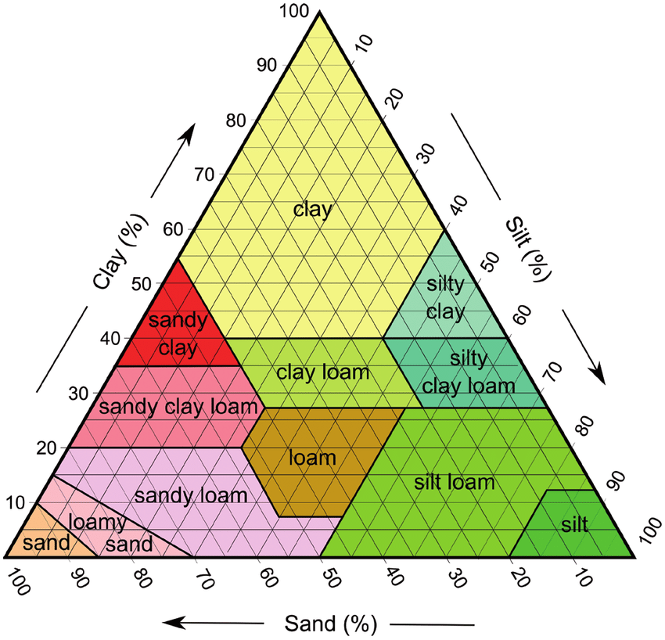
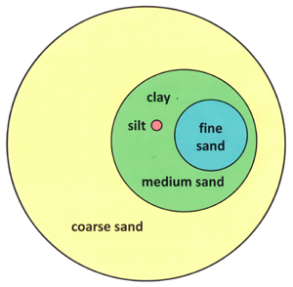
Soil Triangle
On the right is a soil triangle. It classifies soil based
on percentages of sand, silt, and clay. This can be
tested in a number of ways. Note that loam is an optimal
mixture of the three.
Below is a comparison of these mineral components
by size. Clay particles are barely visible, even at this
scale.

Slide 4
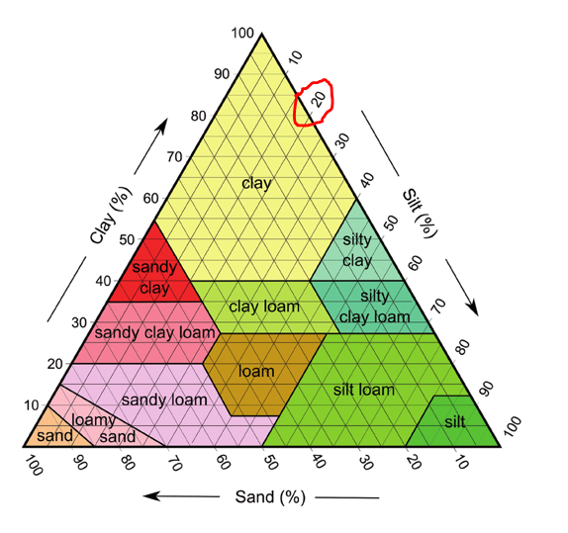
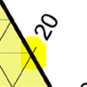
Reading A Soil Triangle
Reading a triangular graph is almost like reading a
normal two axis square plot.
The key difference is to follow the lines coming off
of the scale axis as if they are perpendicular.
Anything along the sloped highlighted line
will be 20% silt, by example.
Loam is the ideal soil breakdown, which will be
approximately 20% clay and 40% sand and silt.
Try to follow from the axes to the centre to
understand this breakdown.

Slide 5
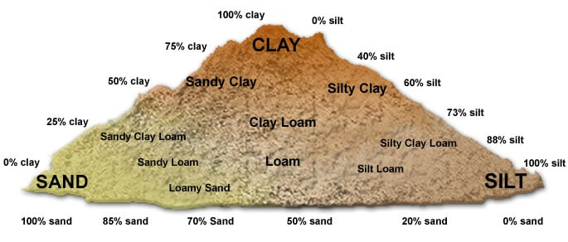
Soil Triangle Visualized

Slide 6
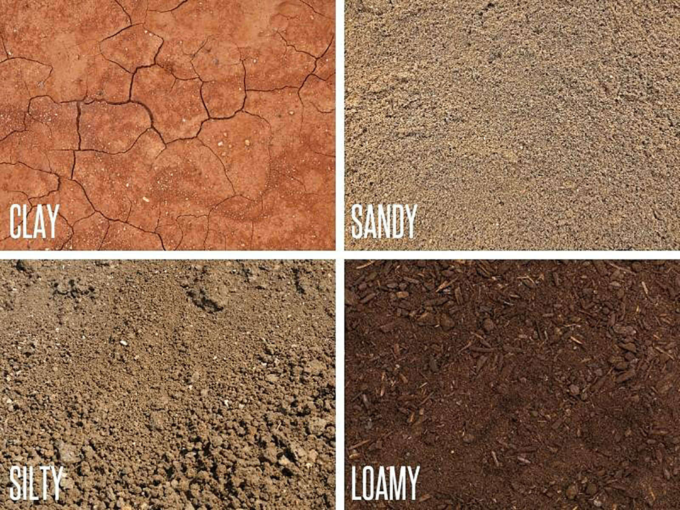
Applications of Soil Type
Independent of mineral content, any soil with relatively
large proportions of organic matter tends to be productive.
Within the soil triangle:
Soils that that are higher in sand drain better
This is due to greater spaces between larger particles
Conversely, clay rich soil requires less water
Small particles are closer packed, inhibiting water movement
Clays (as well as organic matter) are important within soil as they are
negatively charged
This allows them to attach themselves to positively charged
plant micronutrients such as calcium and magnesium cations

Slide 7
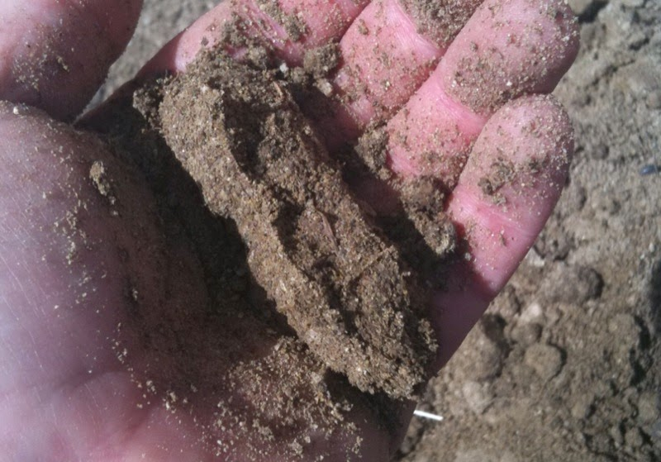
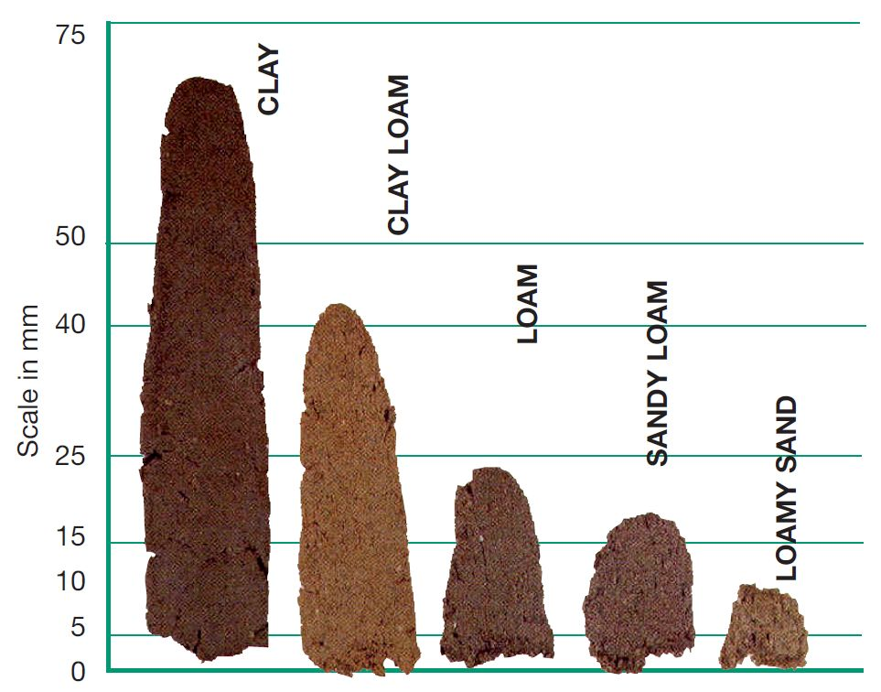
Soil composition tests:
Ball test:
Moisten a small amount of soil and squeeze it in your hand
High Sand: Will not hold its shape, feels grainy
High Clay: Will strongly hold its shape
High Silt: Will hold its shape
Loam: Barely holds its shape, crumbles when poked
Ribbon Test (works best in clay soils):
Create a soil tube by rolling it into a “ball” like above
Press it into a line in your palm with your finger
See right for the relative lengths of the ribbons
You can also find the nutrient or organic matter content by counting if there are many or few worms
More worms means more organic matter

